Slide 1




SEGMENTATION USING CUSTOMER LIFETIME VALUE HYBRID K-MEANS AND ANALYTIC HIERARCHY PROCESS
Thesis Defence – Master of Science Management
Radit Rahmadhan
29020003
Supervisor : Meditya Wasesa, Ph.D.
Examiners : 1. Dr. Manahan Siallagan 2. Prawira Fajarinda Belgiawan, Ph.D.
Bandung, 22 December 2022

Slide 2


The
The Outline of Presentation
01 | INTRODUCTION
Background and Problem Statement
Research Question and Research Objectives
Research Method
Research Scope
Customer Segmentation Based On Electricity Consumption Data
Customer Segmentation Based On Customer Lifetime Value
Marketing Strategy in Customer Relationship Management
Research Position
02 | LITERATURE REVIEW
Research Philosophical Position
Research Framework
Data Collection
Data Cleaning, Choice Of Variable
Clustering Model
Marketing Strategy Definition
03 | METHODOLOGY
Results of Clustering
Results of Customer Lifetime Value
Implementation of Customer Relationship Management
04 | RESULT AND ANALYSIS
05 | CONCLUSION
General Conclusion
Research and Practical Implications
Limitation and Further Research

Slide 3

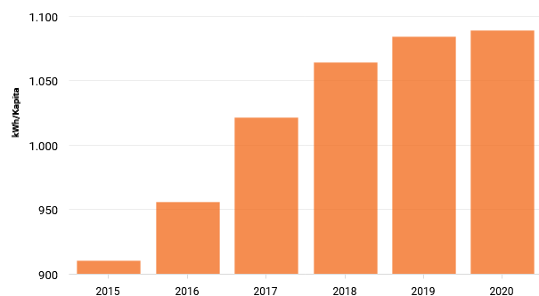

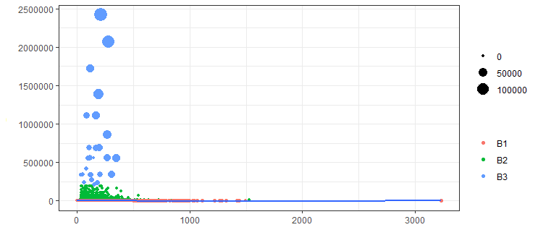
Background and Problem Statement
Source: Katadata.co.id
Business Customer
Source : Interview Results from several PLN customers in the West Sumatra Zone
Electricity consumption in Indonesia increased by 98.89%
Electricity blackouts occur up to four times a month.
Source : PLN customer transaction data for West Sumatra Region from 2019 to 2020
Source : PLN customer transaction data for West Sumatra Region from 2019 to 2020
Low consumption of business customers due to power outages (below 50 hours per month)
Customers using more than 200k of power during peak load than off-peak electricity while during non-peak load hours, usage is low.
01 | INTRODUCTION

Slide 4




Research Questions and Research Objective
RQ1
“How to develop an accurate customer segmentation model according to the characteristics of electricity customers using West Sumatra Zone business customer transaction data? “
Objectives :
To develop a hybrid model of customer segmentation to find the right grouping of electricity customers according to their consumption patterns.
RQ2
“How to implement marketing strategies according to customer criteria based on the results of the customer segmentation model?
Objectives :
To apply the concept of Customer Relationship Management (CRM) Strategy according to the characteristics of its customers in order to meet the demand for electricity effectively.
01 | INTRODUCTION

Slide 5
Research Method and Research Scope
Research Method
Research Scope
This research adopted and modified the predictive analytics framework by (Shmueli & Koppius, 2011) to develop a hybrid segmentation model
01
This study focuses on the electricity consumption of business customers specific to the Padang region
02
This study used one month of business customer transaction data
1
2
Data Collection
Data Preparation
03
This study examines proposed using a combination of machine learning models namely K-Means Clustering, Customer Lifetime Value and Customer Relationship Management (CRM) strategies
5
4
3
Model Use & Reporting
Model Evaluation
Model Development
01 | INTRODUCTION

Slide 6
Customer Segmentation Based on Electricity Consumption Data
Article | Business Context | Dataset | Segmentation Features | Segmentation Method
(McLoughlin et al., 2015) | Electricity Load Profile in Ireland | Experimental data period January 1, 2009, to December 31, 2010, | Dwelling type, No. of bedrooms, Age, Social Class, Electronic Type | K-means, k-medoid and Self Organizing Maps (SOM)
(Jang et al., 2021) | Electricity Load Profile | Smart Metering Data in 2009 | Identity, Social Status, age, gender, Demand kWh, Income | Regression Ordinary Least Square (OLS), Evaluation (Root Mean Square Error (RMSE))
(E. Lee et al., 2020) | Electricity Load Profile | Residential Demand Data during November,2017 until Febuary, 2018 | Identity, Daily Consumption, Load Profile, Peak Hour, Demand | K-means, Fuzzy C-Means (FCM) and Self Organizing Maps (SOM)
(Afthoni et al., n.d.) | Electricity Consumption in Indonesia | Customer Transaction in September 2021 | Rate, Power, Total kWh, Total Cost, Flash Time | Model (K-Means),Validity (Silhouette Method) combines (Customer Relationship Management (CRM))
Few studies on combining K-Means with CRM Concepts
There are no previous studies that use peak load and peak off load variables
There is no previous study that combines K-Means with Customer Lifetime Value.
Most studies incorporate other clustering in customer segmentation
02 | LITERATURE REVIEW

Slide 7
Customer Segmentation Based on Customer Lifetime Value
Study | Business Context | Dataset | Segmentation Features | Segmentation Model
(Ye, 2021) | Supermarket Marketing | Customer Transaction Data 2021 | LRFM Variable | Customer Lifetime Value
(Kafkas et al., 2021) | Transportation | Survey transportation 2021 | LRFM Variable | K-Means Clustering and CLV Model
(Koponen et al., 2021) | Small and Medium Enterprises | Customer Transaction Data in data server AR-Pulsabiz | LRFM Variable | K-Means Clustering and CLV Model
There is no previous research that uses power, peak load and peak off load variables in the CLV model.
There is no previous research that uses K-Means, CLV, CRM in the context of electricity.
Most studies combine K-Means with Customer Lifetime Value and LRFM Variable
02 | LITERATURE REVIEW

Slide 8
Marketing Strategy in Customer Relationship Management
Sustainable Marketing |  | One to One Marketing
Continuous Replenishment Program | Business to Business | Customer Business Development | Retail Account Marketing
This program is used for less profitable customers (Yudhya, 2019). Approaches to programs such as partnership programs to encourage increased use of the company's services to customers (Dias et al., 2021; Yudhya, 2019). | This program is used for profitable customers and Middle Profitable Customer (Kulej-Dudek, 2021; Sekizaki et al., 2016). The approach to this program is like providing special executive services to customers to improve service, so that customer trust will increase and become more loyal (Baniasadi et al., 2021; R. Hosseini et al., 2021; Kafkas et al., 2021; Xie et al., 2021). | This program is used for profitable customers and Middle Profitable Customer (Borisavljević & Radosavljević, 2021; Daat et al., 2021). The approach to this program is to assess the benefits of marketing, finance, and management business processes (Borisavljević & Radosavljević, 2021; Kulej-Dudek, 2021). | This program is used for less profitable customers (Yan et al., 2018; Yudhya, 2019). The approach to this program sees the customer as a partner to develop business opportunities. This program performs customer profiling further by using CRM, which is more integrated into the application (Dias et al., 2021; Sekizaki et al., 2016).
02 | LITERATURE REVIEW

Slide 9
Research Positioning
02 | LITERATURE REVIEW

Slide 10
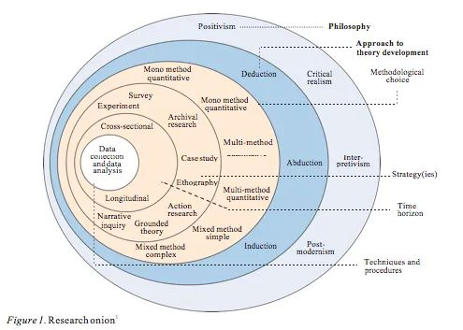
Research Philosophical Position
Pragmatism
Deduction
Quantitative Method
Case Study
Longitudinal
Quantitative Data Collection
03 | Methodology

Slide 11
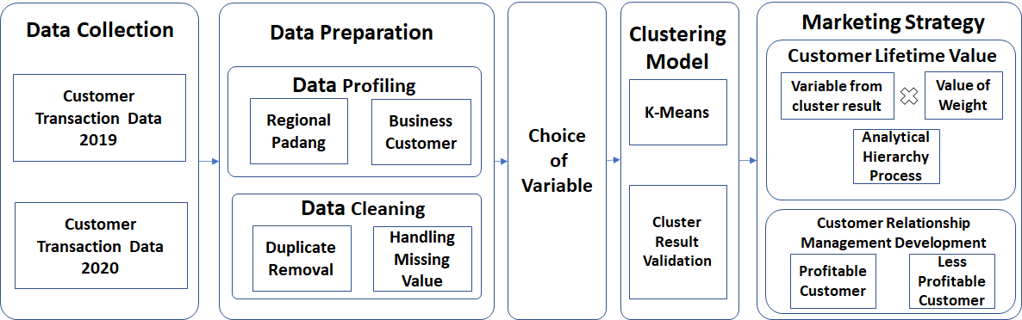
Research Framework
03 | Methodology

Slide 12


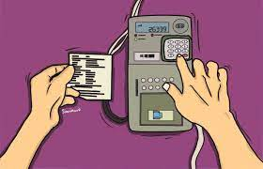

Data Collection
PT.PLN Persero West Sumatera Region Data
Data | Year | Row | Variable | Data Used
Customer Transactions history | 2019 | 7,945,689 | 107 | July,2020
Customer Transactions history | 2020 | 8,558,539 | 107
Total Data |  | 16,504,228 |  | 1,835,212
03 | Methodology

Slide 13
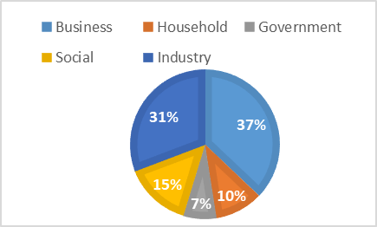
Data Preparation
Data Profiling
Regional
Customer
Padang area has the highest electricity consumption compared to other locations.
Focuses on business customers
03 | Methodology

Slide 14

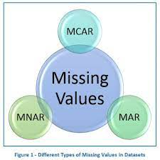
Data Preparation
Data Cleaning
Data Cleaning Description
Variable | Data Type | Count | Max | Min | Variable Description
ID Customer | Integer | 24,785 | - | - | Identity of the customer
Customer Service Unit | String | 12 | - | - | Customer Service Units or service branches provided by the company which are in 4 customer service centers namely Belanti, Painan, Indarung, Pariaman, Lubuk Basung, Lubuk Sikaping, Koto tuo, Baso, Sijunjung, Sungai Rumbai, Kayu Aro, Sawah Lunto, Batusangkar, Lintau, Lima Puluh Kota and others
Data Entry Date | Date | 24 | 2020/12 | 2019/01 | Admin enters data per 1 month
Rates | Categorical | 3 | - | - | B1 means a business that uses electricity from 450 kWh to 5500 kWh, B2 means a business that uses electricity from 6600 to 200 thousand kWh, B3 means a business that uses 200 thousand kwh of electrical power and above
Power | Integer | 43 | 2,425,000 | 450 | Power used by customers such as 450 kwh,900 kwh,1,300 kwh, 2,200 kwh,3,300 kwh, 7,700 kwh,15,400 kwh,132,000 kwh, 200,000 kwh and others
Meter Code | Categorical | 5 | - | - | M means analogue meter and E means digital meter
Flash time | Double | 2,7904 | 4775.66 | 0 | Electricity usage time by customer
Total KWH | Integer | 1,0427 | 635,370 | 0 | The total of peak load kwh usage and peak external load kwh used by customers
KWH Off – Load | Integer | 10,417 | 500,640 | 0 | KWH used at peak external load by customers
KWH Peak Load | Integer | 1,515 | 146,580 | 0 | KWH used at peak load by customers
Discount | Double | 11 | 338,942 | 0 | Discounts given by the company based on the provisions of the company such as using unused kwh by the company or because of a natural disaster
Peak Offload Fee | Double | 18,578 | 518,552,899 | 0 | Payments made when using Peak Offload
Peak Load Fee | Double | 2,256 | 227,736,949 | 0 | Payments made when using Peak Load
Total Cost | Double | 21,621 | 732,079,768 | 0 | The total cost paid by the customer
Process
Duplicate Removal
Missing Handling Value
This Process focused to duplicate removal and missing value handling
03 | Methodology

Slide 15
Choice Of Variable
Predictive Model Specification
Variable | Data Type | Function | Variable Description
Power | Integer | Predictor | Power used by customers such as 450 kwh,900 kwh,1,300 kwh, 2,200 kwh,3,300 kwh, 7,700 kwh,154,00 kwh,132,000 kwh,200,000 kwh and others
Flash time | Double |  | Electricity usage time by customer
KWH Off - Load | Integer |  | KWH used at peak external load by customers
KWH Peak Load | Integer |  | KWH used at peak load by customers
Total KWH | Integer |  | The total of peak load kwh usage and peak external load kwh used by customers
Discount | Double |  | Discounts given by the company based on the provisions of the company such as using unused kwh by the company or because of a natural disaster
Peak Offload Fee | Double |  | Payments made when using Peak Offload
Peak Load Fee | Double |  | Payments made when using Peak Load
Total Cost | Double |  | The total cost paid by the customer
Customer segmentation | Double | Predicted | The results of the cluster based on the model
Power variables, external load kWh and peak load kWh variables are used as predictions in the clustering model.
03 | Methodology

Slide 16
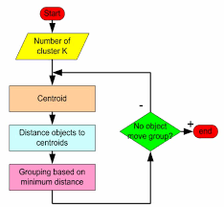
Clustering Model
This study use the K-Means Clustering model to group customers adopt by (Bapna et al., 2004)
01
Determine the number of clusters with elbow method
02
Each data point in the data set will be assigned to the nearest centroid, and then a new centroid is generated.
03
To recalculate a new cluster by assigning all data points to the nearest centroid, and then a new group is created.
04
The process will be repeated between step 2 and step 3 until the stopping criteria are met.
03 | Methodology

Slide 17



Marketing Strategy Definition
Customer Lifetime Value
Analytical Hierarchy Process
CRM Concept
The step from AHP is described below (Al & Al-Harbi, n.d.; Parvaneh et al., n.d.):
Comparing variables based on cluster results
Make a set of pairwise comparison matrices for each lower level with one matrix for each element
The results of the matrix are required for assessment in each pairwise comparison
Hierarchical synthesis is now used to determine the criterion weights taken from all eigenvectors.
After making all pairwise comparisons, consistency is determined using the eigenvalues with formula
$$CI=\frac{λ\max{−n}}{n−1}$$
Where:
CI = Consistency index
$λ maximum$ = the eigenvalue of the predetermined variable value
$$n=number of criteria$$
Steps 3 to 5 are performed for all levels in the hierarchy.
Based on the results of CLV, then we can determine the targeting that aims to develop customer service improvement strategies based on the concept of customer relationship CRM (S. M. S. Hosseini et al., 2010)
Customer Type | Sustainable Marketing | One To One Marketing
Profitable Customer | Business To Business | Customer Business Development
Middle Profitable Customer
Less Profitable Customer | Continuous Replenishment Program | Retail Account Marketing
CLV is calculated based on the CLV rating determined for each segment (Khajvand et al., 2011). CLV equation calculation is as follow:
$$CLV=X_{i}{∗W}_{j}+…+X_{n}{∗W}_{n}$$
where:
X = variables values from cluster results
N = end of the variable and weight based on the number of clustered variables
W = weight of each value of cluster result
I = start of the variable
J = start of the weight
03 | Methodology

Slide 18
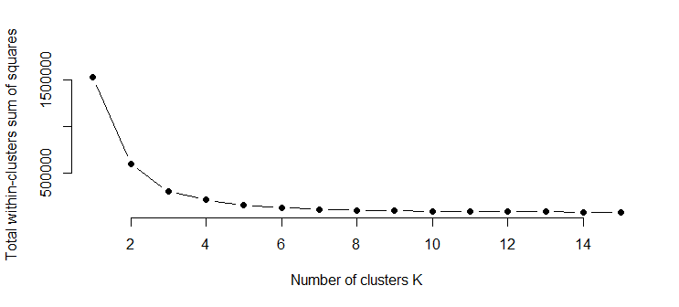
Result Of Clustering
01
Find Correct Variable
02
Determined The Number of Cluster
P | FT | TK | NPL | PL | NPLF | PLF | TC | D | DIM1 | DIM2 | TV
√ | √ | × | √ | √ | × | × | × | × | 69.2% | 25.1 % | 94.3 %
√ | √ | × | √ | √ | √ | √ | √ | × | 79.7 % | 14.3 % | 94.0 %
√ | √ | × | √ | √ | √ | √ | × | v | 65.7 % | 14.4 % | 80.1 %
√ | √ | × | √ | √ | √ | √ | √ | √ | 69.7 % | 12.6 % | 82.3 %
√ | √ | √ | × | × | × | × | × | √ | 47.3 % | 25.1 % | 72.4 %
√ | √ | √ | × | × | × | × | √ | √ | 57.1 % | 20.1 % | 77.2 %
√ | √ | √ | × | × | × | × | √ | × | 71.4 % | 25.1 % | 96.5 %
√ | × | × | √ | √ | √ | √ | × | × | 92.5 % | 5.1 % | 97.5 %
√ | × | × | √ | √ | × | × | × | × | 91.9 % | 5.8 % | 97.7 %
√ | √ | × | √ | √ | × | × | √ | × | 93.2% | 4.4 % | 97.6 %
Determine the number of clustering using the elbow method to get the best number of clusters (k).
Description: P: Power, FT: Flash Time, TC: Total KWH, NPL: Non Peak Load, PL: Peak Load, NPLF: Non Peak Load Fee, PLF: Peak Load Fee, TC: Total Cost, D: Discount, DIM1: Dimension1, DIM2:Dimension2, TV: Total Variant
Find the correct variables to be applied in the clustering model by combining the predetermined variables with the K-Means clustering model.
04 | Result & Analysis
03 | Methodology

Slide 19
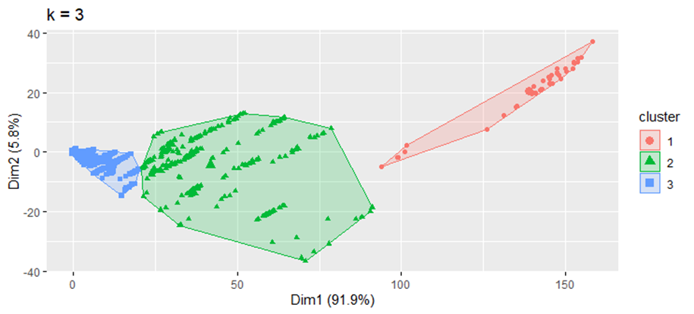
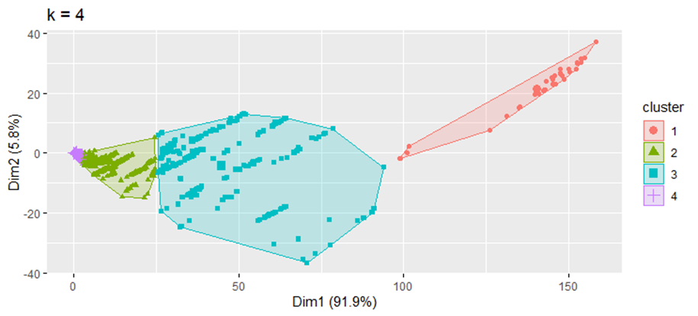
Result Of Clustering
03
Determine the Best Grouping
Visualization at points 3 and point 4 uses the K-Means clustering model. Based on the visualization results, the best grouping of the K-Means clustering model in the electricity consumption sector is at point 3.
04
Result Clustering
Cluster | Number of Customer | Total Power (kWh) | KWH Peak Off Load (kWh) | KWH Peak Load (kWh) | Installed Power (kWh)
1 | 282 | 937,837 | 115,194 | 27,827 | 11,000 -200,000
2 | 508,615 | 4,260 | 544 | 35 | 450- 10600
3 | 37 | 2,226,351 | 390,803 | 123,297 | >200,000
04 | Result & Analysis
03 | Methodology

Slide 20
Result Of Customer Lifetime Value (CLV)
02
Calculate CLV value
01
Determine Weight Value
Centroid | Number of Customer | NP | NKPOL | NKPL | CLV Value
Segment 1 | 282 | 222,267.4 | 45,040.85 | 19,812.82 | 287,121
Segment 2 | 508,615 | 100.962 | 212.704 | 24.9 | 338.586
Segment 3 | 37 | 527,645.2 | 152,804 | 877,787.46 | 768,236.6
Variable | Weight
Power | 0.237
kWh Peak Off-Load | 0.391
kWh Peak Load | 0.712
NP refers to the standard cluster of the amount of power used by the customer as Weighted Power, NKPOL refers to the usual group of the amount of electricity at the time of peak off-load used by the customer is Weighted kWh Peak Off-Load, NKPL refers to the standard cluster of the amount of electricity at load time The height used by the customer is the Weighted kWh Peak Load
The variables we use are power, kWh of Peak Load, kWh of Peak Load calculated using AHP
The calculation is taken from the multiplication between the variable and the weight.
03
Rank Based Result of CLV
Segment | Number of Customers | CLV Value | Ranking
1 | 282 | 287,121 | 2
2 | 508,615 | 338.586 | 3
3 | 37 | 768,236.6 | 1
04 | Result & Analysis
03 | Methodology

Slide 21
Implementation of Customer Relationship Management Strategies
Rank-Based Strategy
01
The appropriate strategy for this group is Sustainable marketing, i.e.:
Business to business: offering special premium service products to use more electricity during off-peak periods.
One-to-one marketing: providing dedicated account executives to customers to provide the best solutions and consultations for electricity problems experienced by customers.
Segment | Number of Customers | Ranking | Strategy Targeting
1 | 282 | 2 | Profitable Customer
2 | 508,615 | 3 | Less-Profitable Customer
3 | 37 | 1 | Profitable Customer
02
The appropriate strategy for this group is Continuous marketing, i.e. :
Business to business: offering premium services without the need to abandon consumer consumption habits during peak seasons.
One-to-one marketing: increase electricity usage during non-peak load periods.
03
The appropriate strategy for this group is the Continuous Replenishment Program : companies are advised to conduct partnership programs to encourage increased electricity consumption, electronic equipment manufacturers to replace non-electric equipment with electricity-based ones.
04 | Result & Analysis
03 | Methodology

Slide 22
General Conclusion
RQ1
“How to develop an accurate customer segmentation model according to the characteristics of electricity customers using West Sumatra Zone business customer transaction data? “
RQ2
“How to implement marketing strategies according to customer criteria based on the results of the customer segmentation model?
Step 01|
Collect the data from PT PLN Persero West Sumatera Zone from January 2019 until December 2020
The third group is profitable customers, the right strategy in this group is sustainable marketing.
The second group is the profitable intermediate customers
The first group is customers who are less profitable because the total electricity consumption per month is 4,260 kWh.
Step 02|
Perform data preparation (i.e., data profiling and data cleaning)
Step 03|
Maintain predictors and predictions from those needed to be processed in the hybrid model of customer segmentation
Step 04|
There are nine variables will be selected which are possible before being processed in the Clustering Model
Step 05|
The segment results will be calculated into Customer Lifetime Value but previously the weight value will be sought from the AHP value of the 3 cluster result variables, then there is an appropriate segment ranking from the processing results
05 | Conclusion

Slide 23

Research and Practical Implications
Contribution to the Literature
This study presents a predictive model using segmentation or customer grouping based on electricity consumption used by business customers in electricity companies.
Managerial Implications
This finding can inform companies to provide more optimal power based on the characteristics of their customers.
Addition
This research help companies improve their targeting strategy for their customer and the corresponding revenue.
05 | Conclusion

Slide 24

Thank You

